Slide 1


The California Community College Council for Staff Development (4CSD)
2022 Annual Conference
Rebecca Ruan-O’Shaughnessy, Vice-Chancellor for Educational Services and Support, CCCCO
rruan-oshaughnessy@cccco.edu
&
Tonya Williams, PhD, Visiting Dean of DEI & Leadership Development, Institutional Effectiveness, CCCCO
lmwilliams@cccco.edu
Notes:
Siria

Slide 2
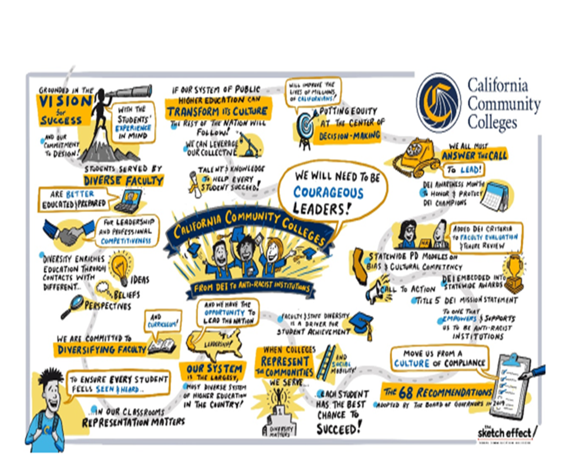
Agenda
Vision for Success Goals & Commitments
Guided Pathways
The New Vision for Professional Learning & Growth
Q&A

Slide 3
Vision Goals
Commitments
Increase credential obtainment by 20%
Increase transfer by 35% to UC and CSU
Decrease average unit obtainment for a degree to 79
Increase employment for CTE students to 76% in their field of study
Reduce and erase equity gaps
Reduce regional gaps
Focus on students’ goals
Design with the students’
experience in mind
High expectations and high support
Foster use of data and evidence
Own student performance
Thoughtful innovation and action
Cross-system partnership
Notes:
Our Vision Remains the Same and Our commitments will continue to guide us.

Slide 4

Guided Pathways
Institutional change that improves student outcomes and closes achievement gaps.
Identifying and eliminating student friction points.
Assuming everything can and should change.
Working together to change student outcomes.
The vehicle for achieving the Vision for Success (https://www.cccco.edu/About-Us/Vision-for-Success).

Slide 5
Guided Pathways: from launch to impact
Act
Contextualizing framework
Seeding local advancements
Learn
Alignment among initiatives
Change
Focus on impact
Making equity explicit
Persistent system equity gaps
Critical infrastructure and mindset shift
Data-informed decision making
Integration of key system reforms
Student-centered approaches
Bring together KPIs, SSMs, SCFF and VFS

Slide 6
GP 2.0 Investment Priorities
Compliance
Integration
Transformation
Implementing system equity priorities with fidelity
Prioritizing teaching and learning
Normalizing KPI-driven continuous improvement
Notes:
Creating the enabling conditions to integrate the equity-driven GP framework into institutional structures and practices to drive structural transformations and efforts towards advancing equity, prioritizing teaching and learning, and promoting data-informed continuous improvement.
Districts/Colleges: Integrating the GP framework into institutional structures and practices, removing student friction points, advancing VFS.

Slide 7


State
Associations
Districts
Colleges
Accreditation
Goals of IEPI
Help colleges increase student achievement and success
Help colleges improve fiscal viability, and
Support colleges avoid audit and compliance issues and accreditation sanctions
Notes:
The Institutional Effectiveness and Partnership Initiative (IEPI), located in the Institutional Support & Success Division, was launched in 2014 to help California’s community colleges and college districts improve their operational effectiveness, specifically focused on helping college improve fiscal viability and avoid compliance and accreditation issues. Our Division is uniquely positions to help boost student success across the system by providing colleges and college districts the high-quality technical assistance, professional development and resource tools needed to achieve the goals and commitments contained in the California Community Colleges’ 2017 Vision for Success.
Enhance professional development opportunities

Slide 8
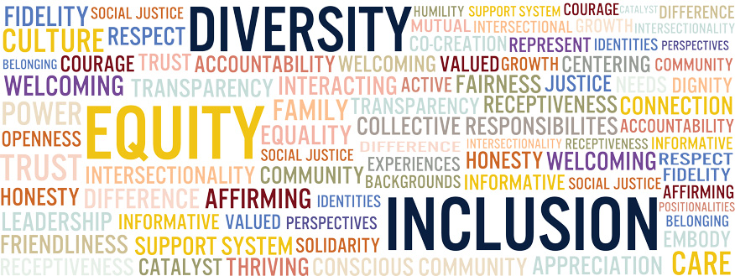
Informed by the VfS goals and other systemwide priorities,
our “ paradigm shifting” vision for professional development is:
Unapologetically student-centered
Equity-aligned & evidence-based
Practitioner led & actionable
Aligned with the needs of the Field
Goal oriented & systems focused
Data informed decision-making
Unless we are consistently working to become anti-racist institutions and become places where inequity cannot survive, then we are contributing to the same disparate results that can be predicted by race.”
-Dr. Regina Stanback Stroud
Notes:
Unapologetically student-centered: how and to what degree do we imagine this intervention impact student outcomes and equitable achievement
Rooted in equity, accountability & learners’ college completion goals
Inclusive, accessible, holistic & practitioner led
Ensure equitable representation of all CC constituency groups in the development and delivery of sponsored professional learning experiences and leadership development activities
Role/Service Area Specific Professional Development
Differentiated Professional Learning Experiences (i.e., entry level to advanced practitioner)
Multiple Learning Modalities (i.e., virtual/online, self-paced, hybrid and in person) & Formats
Aligned with the needs of the Field
Developing multiple feedback loops, expanding partnerships and increasing consultation, coordination and collaboration with constituent leaders, to increase awareness and understanding of structures, systems and processes that thwart progress toward meeting shared interests
We recognize that PD offices and practitioners represent a key lever for equity aligned change and inclusive and representative professional learning experiences for all employees
Complementarity: (non-duplicative with internal/external stakeholders)
Goal oriented, strategically focused & systematically aware
Deepen learner capacity, confidence and connections (3Cs)
Empowering learning with actionable strategies, tools and resources that support cultivating anti-racist, student ready institutions
Strategically focused Investments designed to measurably advance system-wide priorities & IEPI legislative intent
Committed to fostering racial literacy in the use of data, inquiry, discovery, planning, programming & decision-making

Slide 9
Equity at the Center
Technical Assistance
Self-Directed/
Independent Learning
Leadership
Development Programs
System wide
Webinars, Conferences & Workshops
Planning, Research & Reporting
Communities of Practice
Professional Development Framework in Action:
A Multi-Methods Approach for Equity-Driven Change
Notes:
Tonya
Which IEPI goals are actualized through the implementation of the project?
To that end, IEPI has sought to design and deliver technical assistance and professional development programming that demonstrate commitment, vision and strategic movement towards addressing system-wide goals and priorities including but not limited to: reducing and erasing equity gaps in student completion and retention, reducing regional gaps, hastening equitable placement in Math and English, accelerating faculty, staff and administrative diversity, cultivating opportunities for courageous leadership that prioritizes equity in mindset and practice and/or fostering innovations in cultivating a more equitable, inclusive and transformative teaching and learning ecosystem.
We adopted multiple approaches, recognizing that systemic change requires radical reimagination of professional development and technical assistance as an ecosystem of innovation in institutionalizing and integrating DEIA: scope, delivery methods, multiple modalities and access
Institutionalizing and Integrating DEI in Institutional Effectiveness through the provision of technical assistance and professional development. The principle platform or conduit for delivering support, as you’ve learned earlier in the conference, is the Vision Resource Center.
Technical Assistance: A key feature of IEPI is that it draws on the expertise and innovation from within the community college system to advance effective practices and avoid potential pitfalls. The two core components of IEPI’s colleagues helping colleagues’ model has focused on:
Partnership Resource Teams, available to institutions requesting technical assistance seeking support on issues that matter most to them.
System wide Webinars, Conferences & Workshops (i.e, Courageous Leadership & Anti-Racism Bootcamp) Informed by the core commitments of the Vision for Success, these webinars will focus on a range of issues required to becoming antiracist, student ready institutions, including but not limited to:
• Re-designing funding structures by integrating DEI into decision-making processes, allocations, and program review to drive equity-centered student success and support institutional fiscal health and resiliency.
• Leveraging technical assistance and technological innovations to support students’ financial success to accelerate goal completion.
• Designing strategic enrollment management policies and practices as a lever for system wide change in expanding access, outreach, retention and completion.
Equity in Leadership Programs
The objective of the leadership skills development programming, sponsored by the Institutional Effectiveness Partnership Initiative (IEPI), is to build the confidence, competencies and capacity for ongoing individual and institutional transformation to cultivate a more equitable, inclusive and transformative teaching and learning ecosystem. While significant investment in professional learning has been focused on surfacing the why and the what of building anti-racist institutions, providing the strategic rationalization for the urgency of dismantling systemic racism within the system, few professional learning experiences focus on the specific ideas, strategies and techniques for accomplishing system wide goals by institutional role.
Self-Paced Directed Learning Modules
Special Projects in Innovation
Communities of Practice
represent a systems-focused approach to designing and delivering equity-oriented, learner centered and contextually relevant professional development experiences. The CoPs were developed in partnership with other C/O divisions to avoid duplication while leveraging internal and external expertise. The areas of focus are informed by the core commitments and system wide program goals and outcomes delineated in the Vision for Success. The COPs include: Diversity, Equity and Inclusion in Teaching and Learning; Online Learning; Equitable Placement with Fidelity; Dual Enrollment; Credit for Prior Learning; Strategic Enrollment Management; Financial Aid and Basic Needs; and Curriculum Review for Law Enforcement and First Responders
We’ve undertaken this strategic intervention in our PD architecture in close consultation and coordination with campus leaders, subject matter experts and capacity building providers with proven results of improving student success and institutional effectiveness.
Fosters awareness or deepens understanding of system-wide goals and priorities
Strengthens equity-aligned mindsets and behaviors grounded in every individual taking ownership of equitable student outcomes
Facilitates observable changes in practice and policy at the local level that will demonstrably impact student outcomes and equity goals
Provides opportunities for shared learning, networking, skill building and community building
Development of actionable strategies to effectuate change within the learner’s respective areas of influence
Identify, develop, & share evidence based guidelines, tools, resources and/or other learning artifacts with the Field
The Vision Resource Center is the medium

Slide 10
In service to building a better, more inclusive, equity-centered teaching and learning ecosystem, ComPs are rooted in:
Fostering awareness and understanding of the Vision for Success, system-wide DEIA goals & commitments and key Chancellor’s Office priorities
Deepening commitment and enhancing competencies in anti-racist curriculum design, pedagogical strategies, and professional practice
Facilitating observable changes in practice, process and policy, aligned with equity, at the local level
Providing opportunities for reflection, shared learning, community building and co-design of actionable, evidence-based strategies for continuous improvement
Providing opportunities to identify, develop, and share tools, resources and/or other learning artifacts
Communities of Practice (ComPs) represent a key lever in the professional development infrastructure at the systems level
Notes:
We are engaged in a paradigm shift in our thinking and action, anchored in our commitment to becoming anti-racist, student ready institutions, ComPs serve as a key level or conduit for facilitation and movement building towards those ends

Slide 11







Partnerships Anchored in Equity and Innovation:
Aligning, Communicating and Advancing
Key Chancellor’s Office (CO) Priorities through ComPs
Basic Needs & Financial Aid
Credit for Prior Learning
Equitable Placement, Support & Completion
Strategic Enrollment Management
Dual Enrollment
Online Learning
Teaching and Learning

Slide 12



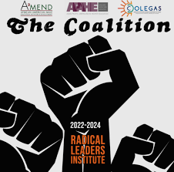

Partnerships Anchored in Equity and Innovation:
Transforming Mindsets, Systems, & Structures Through
Leadership Development & Career Advancement
Classified Professionals Leadership & Career Advancement Series
Advancing Leadership Institute for Instructional VPs in Equitable Education (ALIVE)
Aspiring Radical Leaders Institute
Pipelines to Possibilities
*The Wheelhouse Institute on Leadership Fellows Program

Slide 13
Planning, Research and Reporting:
Building a culture of continuous improvement
Planning
Periodic consultation & coordination with stakeholders
Participation in the stakeholder professional convenings
Periodic PD needs assessment surveys
Research & Evaluation
Internal evaluation of IEPI sponsored PD
Reporting & Programming
Annual State of PD Report for IEPI sponsored PD activities
Periodic review of survey data & scholarship on workforce needs, interests and expectations
Design, execution and evaluation of PD informed by feedback from students, the Field & aligned with CO priorities

Slide 14


Questions and Answer (Q & A)
Join the IEPI Listserv:
https://tinyurl.com/37xk4khz
Notes:
lessons learned about partnerships with the CO
overcoming resistance to DEIA implementation in teaching and learning

Slide 15


