Slide 1
The Nuts and Bolts of Being a Professional Development Practitioner: Everything You Need to Know! 4CSD Virtual Conference March 4, 2022
Say ‘hello’ in the chat by sharing your name, college, and your role/title
Leslie Carr, Director Professional Development, College of the Canyons
Teresa Ward, Faculty Professional Development Coordinator, Butte College

Slide 2
Who is in the room?
L
Administrator
Classified Professional
Faculty
Other

Slide 3
Today’s Agenda
Professional Development Structure at other colleges
Why it is important to assess the needs of your institution
Evaluating if your program(s) is working
How to create PD programming for all employees
Using Chancellor’s Office Resources to Strengthen Your College’s PD Programming (Vision Resource Center)
How to be strategic in PD Programming
Notes:
I really like these colorful boxes!

Slide 4
Committee Structures
One general committee?
One committee for each constituent group?
This Photo by Unknown Author is licensed under CC BY-NC-ND

Slide 5
College of the Canyons Committee Structure
L
Director
Professional Development
Coordinating Committee
CHAIR
Committee Chairs serve on Coronating Committee
CHAIR
Committee Chairs will serve on Coordinating Committee
CHAIR
Committee Chairs will serve on the Coordinating Committee
Administrative
Development Committee
Classified
Development Committee
Faculty
Development Committee
Deputy Chancellor and Chief Diversity, Equity and Inclusion Officer
Assistant

Slide 6
T
VP Institutional Effectiveness
President
VP Instruction
Classified Coordinator
Management Coordinator
Faculty Coordinator
Classified Task Force
Steering Committee
Flex Committee
Notes:
Add Orange Coast and Coastline program models

Slide 7
Your Turn! Connect & Share How to you get employees invested in college professional development?
Notes:
Include photos of past conference attendees

Slide 8
Collaborate to garner campus-wide support for professional development
Listen and ask for ideas and input on training ideas and speakers
Thank employees for participating
Include employees in PD decision-making for their constituent group
Ask employees to present workshops, mentor new employees, serve on a PD committee, make recommendations for guest speakers, etc. – GET EMPLOYEES INVOLVED!
Ideas for Working Collegially with all Employee Groups:
Notes:
I encourage you to find partners internally that have oversight in areas where you can leverage their services or expertise to serve the needs of your employees. Find ways to get everyone involved in moving PD forward.
Add: Support from the top is essential!

Slide 9
Needs Assessment Surveys
Use existing and/or other college models as a springboard
Partner with campus research team to develop and design the survey
Consider using focus groups
Include items on preferred delivery method and timeframe
Use results to inform PD trainings, events and activities with respective constituent committees
Consider doing an Annual Survey of all employees
Notes:
What happens when you don’t evaluate your Professional Development activities?
A needs assessment really asks employees the question, “What do you Want to Learn?”
Make it cute!

Slide 10
Evaluations
Collect at every PD activity
Use to provide needed reporting data (Ex: grants, special funds, annual PD report to Chancellor’s Office)
Find ways to automate process (Ex: Survey Monkey)
Notes:
Evaluations are different than say an annual all employee needs questionnaire. These evaluations do not need to be anything complicated –evaluations can be about the reaction to their experience and what was missed or learned, for example.
What is the most important here is to collect these evaluations at every PD activity. You could even construct items that provide needed reporting data for grants or special funds and demographic questions.
And if you are short on time like many of us, find ways to automate the collection process. For example at COC, I use Survey Monkey for our classified, faculty and administrator needs assessment surveys.
You are highly encouraged to do evaluations for every PD activity.
What could happen when you don’t evaluate your Professional Development activities? (CHAT)
Orange Coast College Evaluation & Assessments
Link to report: https://drive.google.com/file/d/0B4tAg7uAmZzdRW9fSERSaVNvZFotU01NRFFCcjNrUS1BTmpv/view?usp=sharing
Evaluations:
Collected at all trainings
Assessing reactions and encourages application
Standardized post-training survey
Automated
Integrated with LMS
Hybrid format
Needs Assessment Surveys
Designed by all constituent groups
Institutional Research Partnership
All constituent groups assessed
Every other year
Informs planning

Slide 11
In breakout groups share:
Name
College
Role/position
One PD activity that is going well
Notes:
Speaking of evaluations and looking at what is working well, it seems that we have a little time for you to connect with the people in this space. You will be randomly placed in small groups and in your groups you will spend about 3 - 4 minutes to share your name, college, PD role and one PD activity that is going well.

Slide 12
Getting Support & Buy-In for Your Program
Communicate with administrators about upcoming events and ask them to encourage their employees to attend.
Ask administrators to provide office coverage so employees can attend.
Tie everything you do to one of your college’s strategic goals.
Use publications/marketing materials to keep Professional Dev on everyone’s radar.
This Photo by Unknown Author is licensed under CC BY-SA
Notes:
Research consistently shows that beyond a persons own motivation the direct manager is the most influential person when it comes to professional development.
This slide is all about getting support for your program. I already mentioned the first on the list. The other one highlighted here is to help shared governance groups and stakeholders clearly see the connection from your programs to your colleges goals.
Hold up samples of flyers and other publications
Don’t focus on those who may be “quietly quitting” or RIP…focus on those employees who are eager to learn, interested in learning, excited to learn

Slide 13
There are MANY ways to fund PD!
General Fund
Student Equity & Achievement
Grants
AB 1840 (Classified PD Funding)
Needs Assessment Findings: Making a Case for Additional Funding
Notes:
What pots of funding are available?
The key here, especially for anyone that operates on near 0 budget, Research which “pots” are available” and who “controls” them:
General Fund
Student Equity, SSSP, Basic Skills, Diversity, Guided Pathways
Grants (i.e. Title V)
Utilize Needs Assessment and Committees to determine line items such as:
Campus Wide Initiatives (i.e. Retreats, Leadership Academy, Technology Training, Cultural Diversity, etc)
Memberships
Support for travel and other projects identified by individuals, constituency groups or divisions
Presenters/Facilitators
Hospitality
Supplies

Slide 14
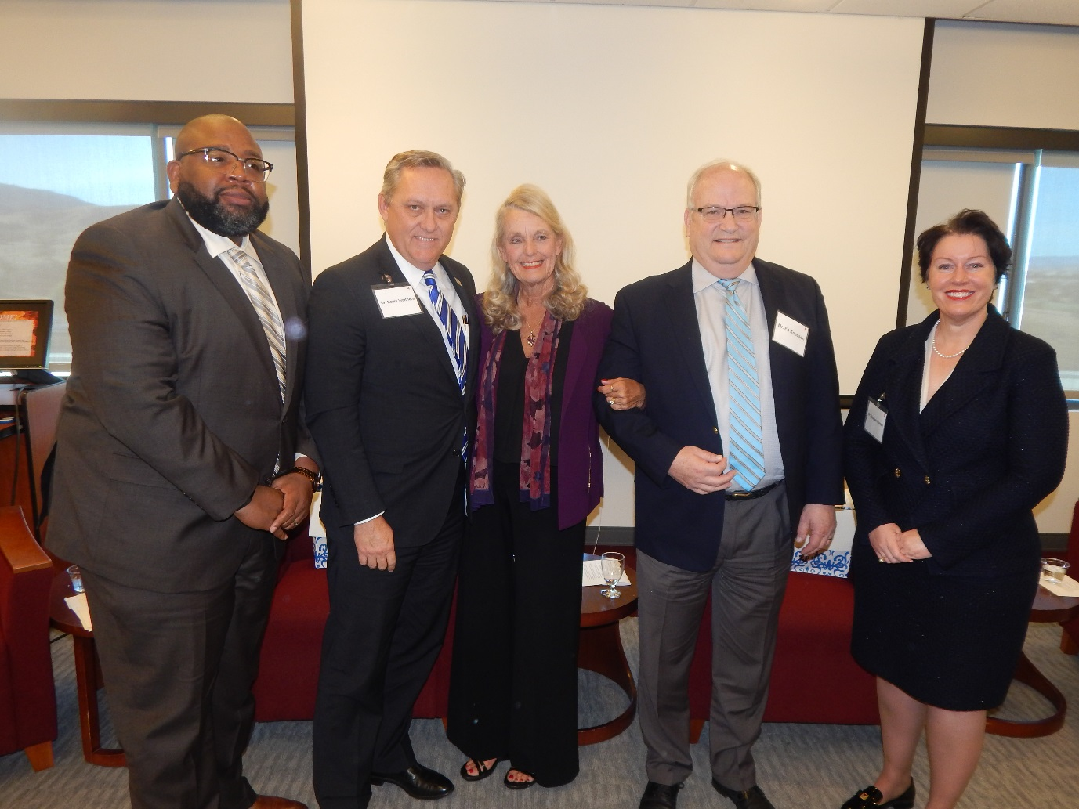
Hiring Presenters
Negotiate!
Collaborate with a neighboring college to share costs and encourage interaction among employees
Invite presenters to provide a follow-up session several months later
Leverage multi-college systems to maximize resources (participation and cost)
Notes:
This slide offers tips for hiring presenters you can come back later to reference.

Slide 15
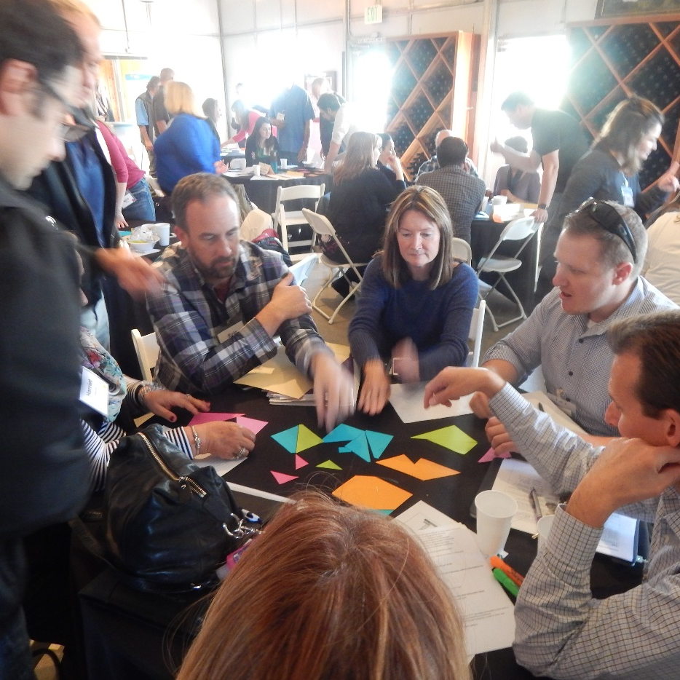
Use Faculty & Staff Expertise!
LT
Benefits and challenges with “outsiders”
Tap into the pool of on-campus faculty and staff to present workshops
Engage long-time employees to present workshops and/or mentor new employees
Create Community
Build Leaders
Photo: College of the Canyons
Notes:
If you are part of a multi-college system, we encourage you to partner with your sister colleges in your district.
Inclusion should be part of the fabric of PD

Slide 16
Learning Communities that allow CCC employees to communicate across colleges on a variety of topics.
Professional Development Community.
The opportunity for employees to create a personalized professional development plan.
Upload your own training content.
A system-wide events calendar.
Thousands of FREE online trainings.
Notes:
Understanding the Vision Resource Center and What It Can Do for You! Thurs, Oct 13 11:30 – 12:30

Slide 17
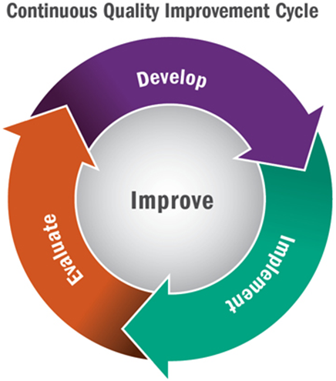
Sample PD Program Plans
Orange Coast PD Program Plan https://www.claudiamontoya.com/uploads/1/2/2/4/122473797/strategic_prof_dev_plan_occ_2019-2022.pdf
College of the Canyons PD Program Plan https://www.canyons.edu/_resources/documents/administration/pd/COCProfDevProgramPlan2020-21.pdf

Slide 18
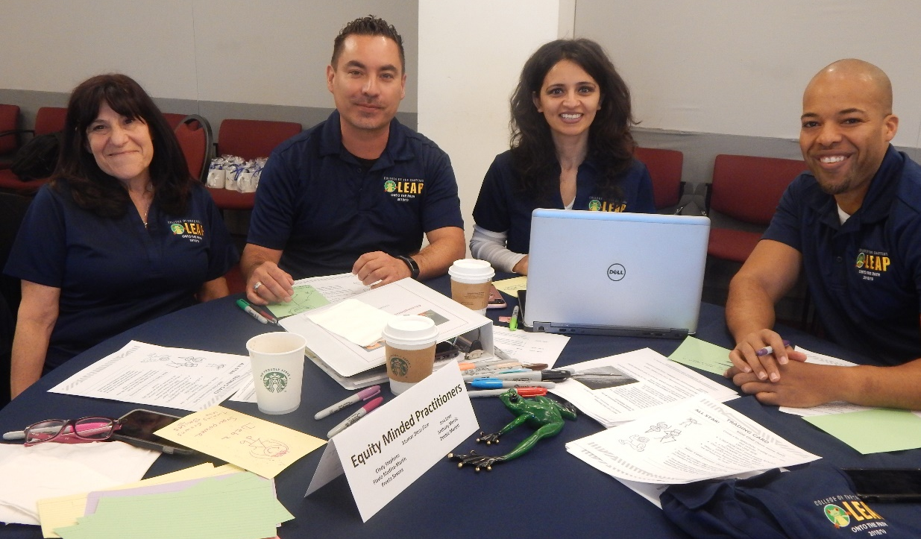
Professional Development at College of the Canyons
LEAP – Leadership Education in Action Program
Management Academy
Summer Technology Institute
Office Professionals Institute
Pathways Professionals Institute
L
www.canyons.edu/pd
Notes:
Engage in a variety of Professional Development programs that will enhance your job application, your employee evaluation, etc. This shows that you are committed to on-going training and development and desire to enhance your skills set.
Claudia – add OCC content here

Slide 19
What is FLEX?
1981 Legislation (AB 1149) allowed colleges option of adopting Flexible Calendar Program
Colleges can choose to reduce 175 day instructional calendar from 1-15 days
Purpose: To provide time for faculty to participate in developmental activities related to staff, student and instructional improvement
Notes:
Need to combine the slides:
Flexible calendar allows colleges to reduce the 175 instructional calendar dedicated to instruction to as low as 160 days which means that you can have anywhere from 1-15 days that are counted as flex/PD days. The average that most colleges have is 5 – that is the state average.
Orange Coast has 2 Flex Days
Butte College here has 11-12 Butte
and CoC has 10 days.
And this is negotiable with the faculty union.
Make this look pretty!
Updating and Equitizing FLEX Guidelines and Title 5 – Thurs, Oct 13 10:15 – 11:15am
Creating a Culture that Promotes and Supports Campus-Wide and District-Wide PD – Thurs Oct 13 3:15 – 4:30pm
Working Session: Equal Employment Opportunity PD Programming Fri Oct 14 9:15 – 10:15am

Slide 20
Flex Reporting
L
Campuses must track & maintain records for at least 3 years
Pay “adjusted” accordingly
Annual Flexible Calendar Program Certification that details all proposed FLEX activities by their appropriate Chancellors office category due to Chancellor’s Office by June 1st
Adjunct FLEX Pay/Requirements
Notes:
Maintain and tracking: Proof all full time & adjunct faculty completed required FLEX obligation for year. COC uses the Vision Resource Center.

Slide 21
FLEX Categories
Activities must fall under 9 areas in the Chancellor’s Office annual report:
Course Instruction and Evaluation
Staff Development In-Service Training & Instructional Improvement
Program and Course Curriculum or Learning Resource Development and Evaluation
Student Personnel Services
Learning Resource Services
Related Activities Such as Student Advising, Guidance, Orientation, Matriculation Services, and Student, Faculty, and Staff Diversity
Departmental or Division Meetings, Conferences and Workshops, and Institutional Research
Other Duties as Assigned by the District
Other Category that Contributes to the Improvement of Instruction, Administrative, or Student Services

Slide 22
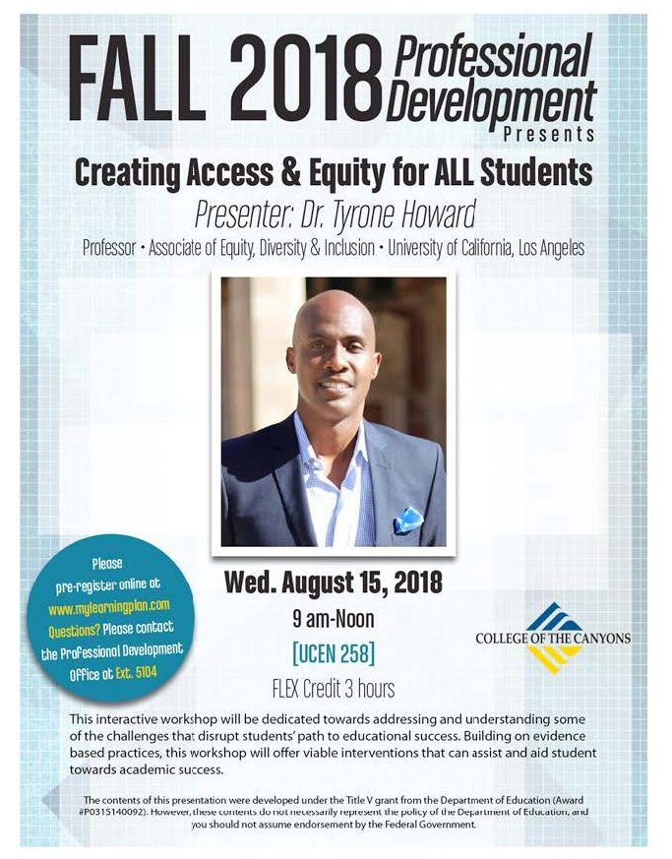
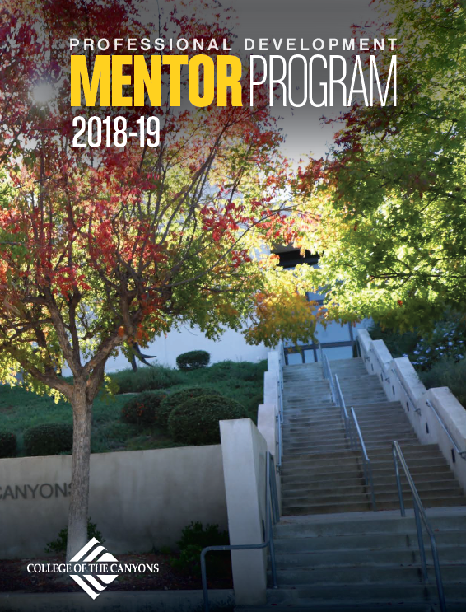
Marketing Your Program
Notes:
Marketing is a GREAT way to demonstrate ROI for your programs. Just like the slide states branding matters it gets your programs in front of employees. Make a simple flyer or booklet for events or activities. Or get fancy and work with your marketing team and do something like this:
Take photos, make flyers, use your logo.
Send email to all employees after key events/trainings with photos to show those who did not attend how much fun their colleagues had.
Claudia – acknowledge and celebrate those who attended a specific training or program via email and cc their supervisor.

Slide 23
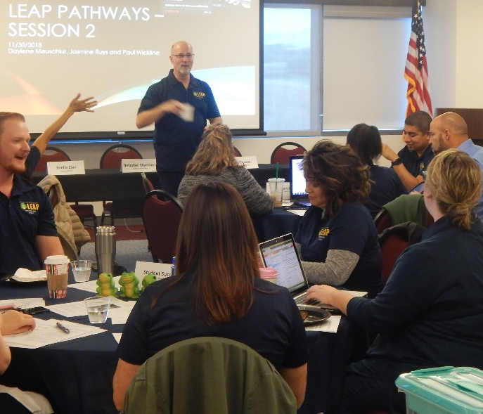
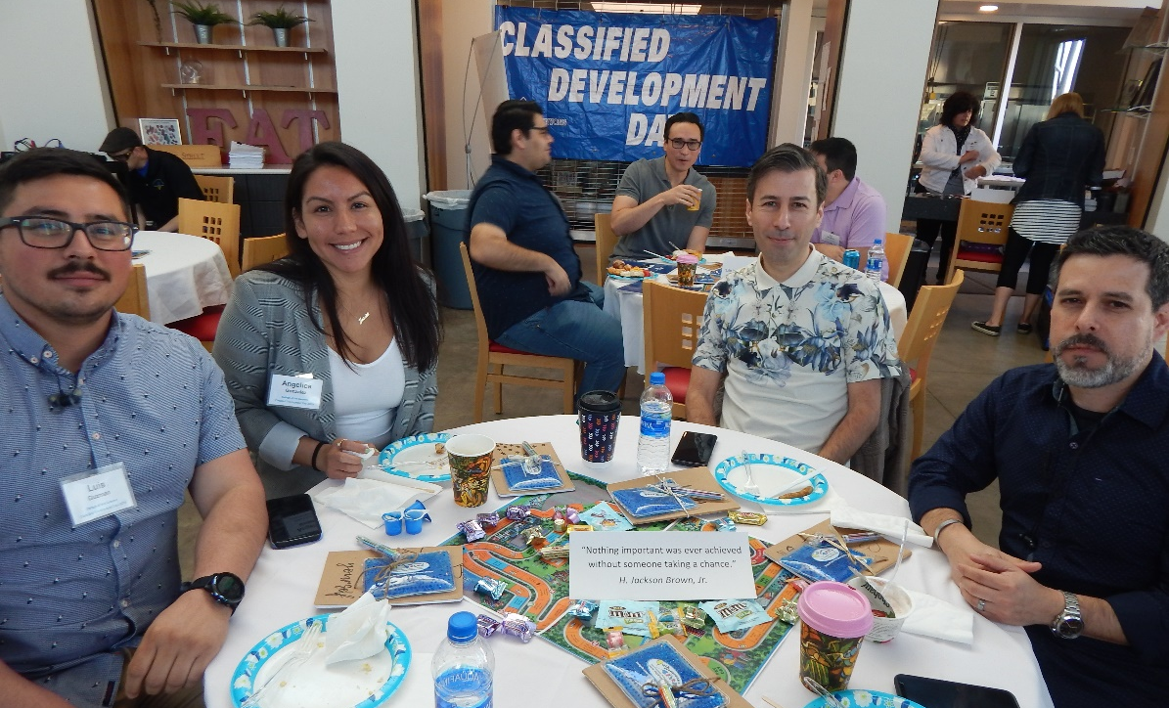
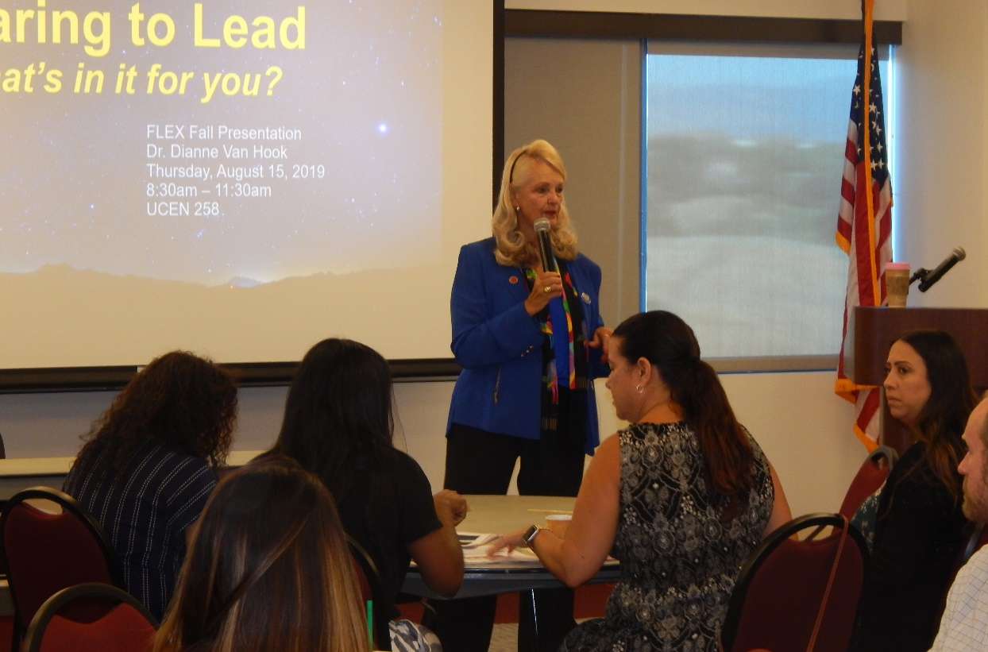
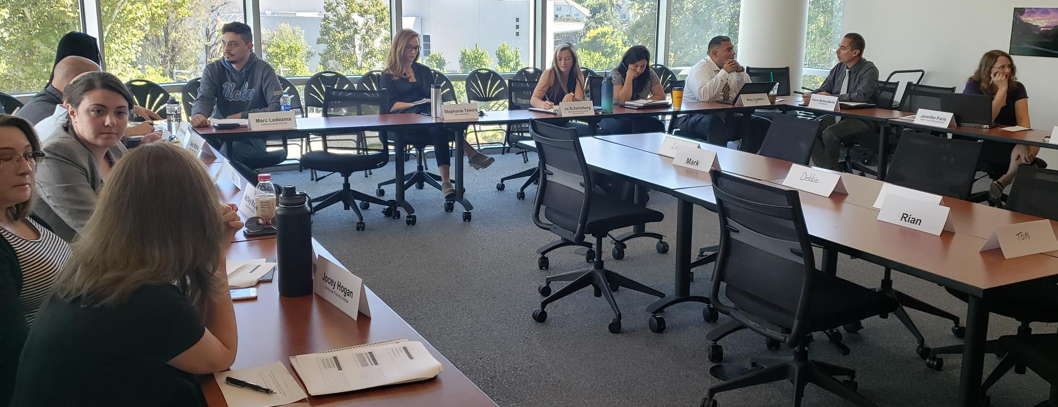
Photos capture the FUN people are having and builds excitement for the next training or event!
Notes:
Part of branding and getting your programs noticed is capturing people while learning. This is courtesy of College of the Canyons pre-pandemic.
And sure, we are unable to do events like these at this time.

Slide 24
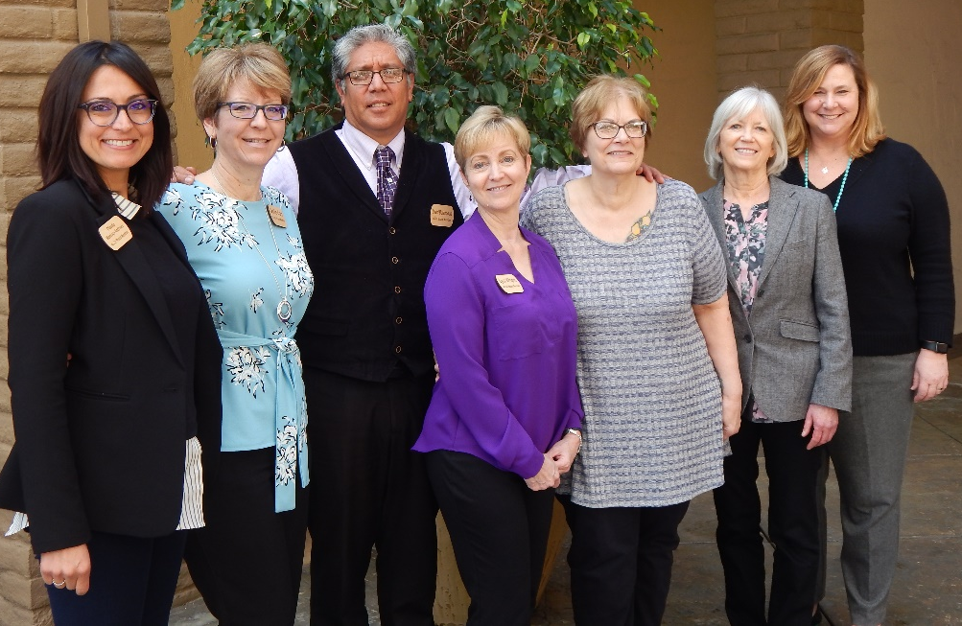
4CSD creates collaborative learning opportunities for professional development
practitioners in the California Community College system in order to foster
innovation and equity at each college. In partnership with the California
Community College Chancellor's Office, 4CSD advocates for funding, resources,
and policy change to enable effective professional learning statewide.
Notes:
Finally, it is part of the 4CSD to advocate for every Professional Development practitioner and support you. We are here as a resource and as such – we want to move to one of my favorite parts of this presentation – questions from you.
Please type your questions in the chat or raise your hand.
STOP SHARE SCREEN

Slide 25
Stay Connected! www.4csd.com
Leslie Carr
Claudia Montoya-Andrews
College of the Canyons
Orange Coast College
Director Professional Development
4CSD Board Member
Leslie.carr@canyons.edu
www.canyons.edu/pd
Learning & Development
4CSD Board Member
Candrews@occ.cccd.edu
www.claudiamontoya.com
Notes:
Interactive activity – What is one challenge you are experiencing? Then, ask table-mates to help resolve the challenge. Write these down and report out at end of activity. Example: New Employee Orientation. MIX THEM UP BEFORE ACTIVITY BEGINS.

