Slide 1
Student Success Paradigm Shift
Office of Equitable Student Learning, Experience, & Impact

Slide 2
Discussion Agenda
Transformation
State Re-Alignment
System Change

Slide 3
Vision Goals
Commitments
Increase credential obtainment by 20%
Increase transfer by 35% to UC and CSU
Decrease unit obtainment for a degree
Increase employment for CTE students
Reduce and erase equity gaps
Eliminate regional gaps
Focus on students’ goals
Design with the students’ experience in mind
Pair high expectations with high support
Evidence-based decisions
Own student performance
Cross-system partnership
Thoughtful innovation and action

Slide 4
Setting the context…

Slide 5
Clarifying our intent…
Reform
Transform
Makes changes in something (typically a social, political, or economic institution or practice) in order to improve it.
Make a thorough or dramatic change in the form, appearance, or character of.

Slide 6
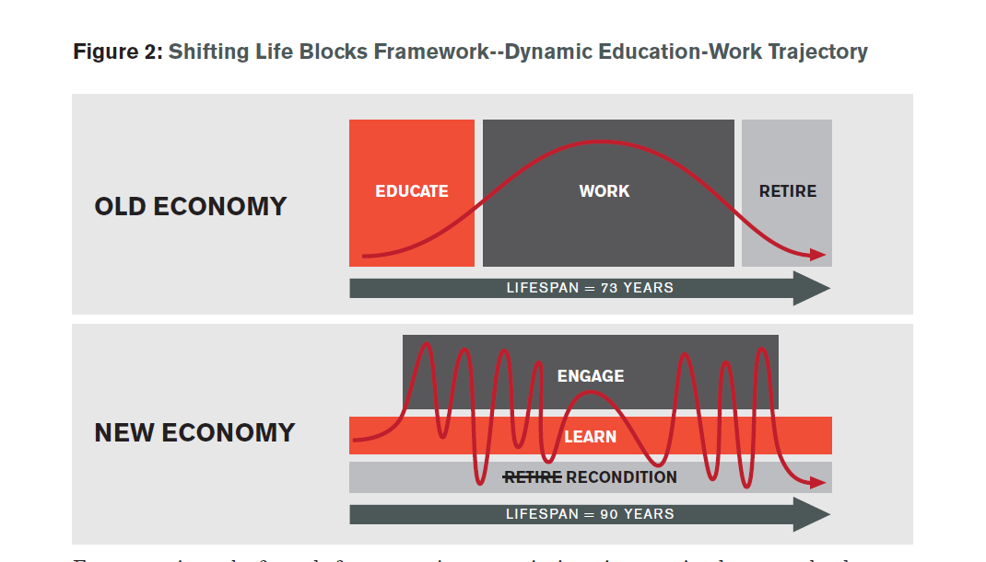
Why transformation…
https://www.linkedin.com/pulse/learning-uncertainty-imperative-heather-mcgowan/

Slide 7
Walking the path of change…
https://www.linkedin.com/pulse/learning-uncertainty-imperative-heather-mcgowan/

Slide 8
Walking the path of change…

Slide 9
Crafting a New Identity
Equitable Student Learning, Experience and Impact Office
We support students by creating the enabling conditions for colleges across the system to adapt, learn and transform policies and practices. We believe every investment, program and initiative is critical to realizing the development of empowered learners, strengthening career mobility for all students, and generating unconditional belonging in every interaction. By deconstructing what historically has been known as academic affairs, student services and workforce and economic development, we are shifting the focus to intentionally organize our work and our impact around student outcomes and their experience.

Slide 10
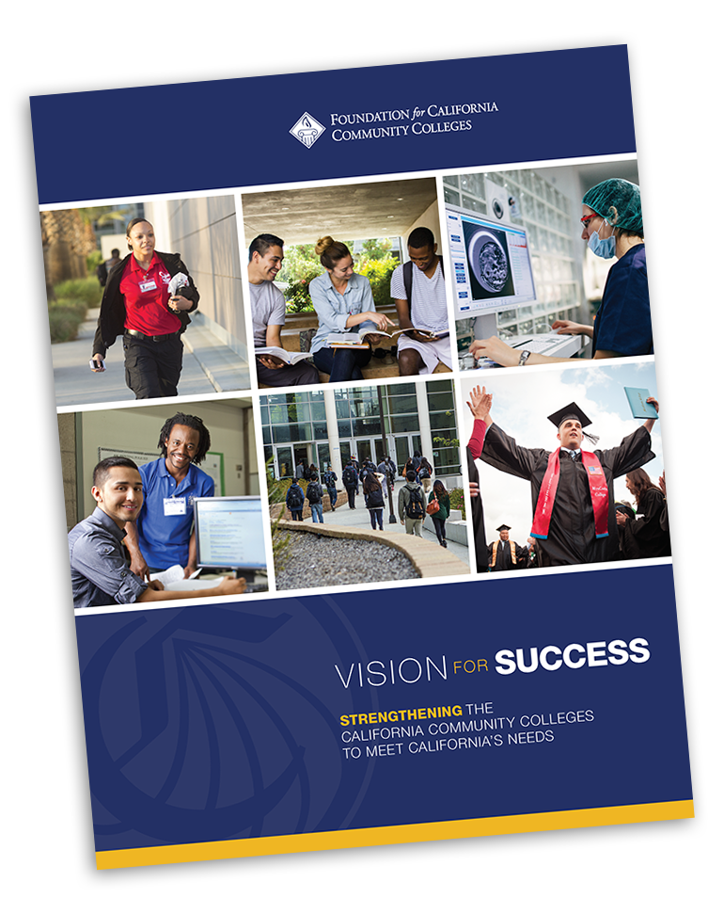
Office of Equitable Student Learning, Experience, and Impact (ESLEI)
Vision Destination: Empowered Learners
Vision Destination: Career Mobility
Vision Destination: Unconditional Belonging

Slide 11
Re-Alignment Purpose
Current Structure
Proposed Structure
Silos: Organized around discreet programs that are not integrated, leveraged, or maximized
Duplication: Program designs and funding can be experienced as duplicative for students, increasing administrative burdens
Misaligned: Standalone communication and guidance reinforces silos and program-focused approach rather than a holistic student approach
Heroism: Isolates program personnel and limits the scope of exposure and experience they receive
Portfolios: Organized around time-bound & outcomes-based efforts that comprise a cohesive & integrated set of projects
Integration: Projects support mutually reinforcing activities across the portfolio and maximizing funding investments
Coordination: Communication and guidance reinforces integration and makes explicit connections and interdependencies for a holistic student-centered approach
Collaboration: Supports a team-centered approach that values diverse perspectives and collective problem solving

Slide 12
Vision Goals
Vision Commitments
Reduce and erase equity gaps
Decrease average unit obtainment for a degree to 79
Increase employment for CTE students to 76% in their field of study
Reduce regional gaps
Increase transfer by 35% to UC and CSU
Increase credential obtainment by 20%
Focus on students’ goals
Design with the students’ experience in mind
High expectations and high support
Foster use of data and evidence
Own student performance
Thoughtful innovation and action
Cross-system partnership
Notes:
So what are we doing to change student outcomes?

Slide 13
Unlearn & Relearning
Guided pathways is more than the four pillars…
Institutional change that improves student outcomes and closes achievement gaps
Identifying and eliminating student friction points
Assuming everything can and should change
Working together to change student outcomes
A vehicle for realizing and achieving the Vision for Success

Slide 14
In the Pursuit of Upstream Thinking
Notes:
https://www.youtube.com/watch?v=0vOwn_WXs3U

Slide 15
Shifting structures
j
Common course numbering
Pass/no-pass and excused withdrawals regulatory action
Direct-assessment competency-based education proof of concept pilots
Diversity, equity, inclusion, and accessibility evaluation & tenure review regulatory action
Campus climate & campus policing taskforce recommendations & regulatory action
Work experience regulatory action
Credit-for-prior learning proof of concept pilots

Slide 16
Focus & Intentionality
Knowledge-Economy Based Policies & Practices
Adaptable Learning Constructs and Modality
Enabling Conditions that Improve Social Determinants
Universal Access to Employment Experiences & Transitions
DEIA Affirming Campus Climates
Inclusive Learning Environments
Shifting Access and Navigation Burdens from Students to Institutions
Supported Network & Learning Leadership
Notes:
The Big Takeaway from the slides we’ve just seen is that progress toward the Vision for Success goals continued, even during the highly disruptive COVID pandemic.
This is a testament to the resiliency of our students and the response of our system, which answered the call during a time of profound crisis.
This graphic shows the ongoing process of refinement and adjustment with critical involvement from the Board of Governors.
One of the important aspects of the how we use our data is to support continuous improvement for the system and at each of our colleges. Colleges work to implement practice, observe what works/what doesn’t, revise their practices, and repeat.
The same process occurs with our data tools themselves – we implement practice, observe what works/what doesn’t, and use that to revise our practices over time

Slide 17
Walking the path of change…
“When we are asking teachers and school leaders to do things they don’t (yet) know how to do, we are not asking them to “implement” something, we are asking them to learn, think, and form their identities in different ways.
We are, in short, asking them to be different people.”
http://www.nysed.gov/common/nysed/files/principal-project-phase-2-elmore-getting-to-scale-piece-journal-of-educational-change-2016.pdf

Slide 18
Thank you!

